Slide 1
Spring 2017 data analysis

Slide 2
Research Questions

Slide 3
Hypotheses

Slide 4
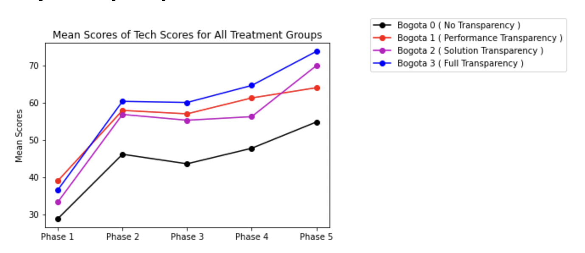
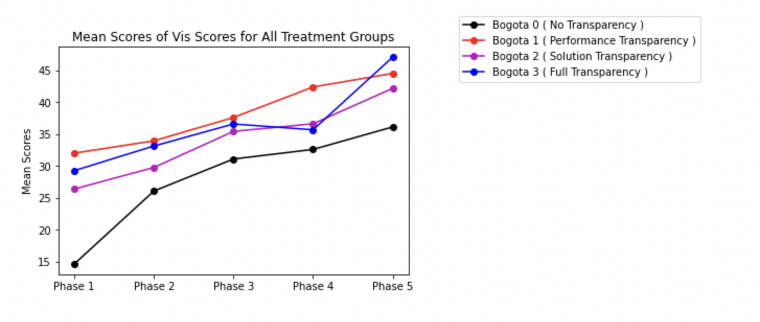
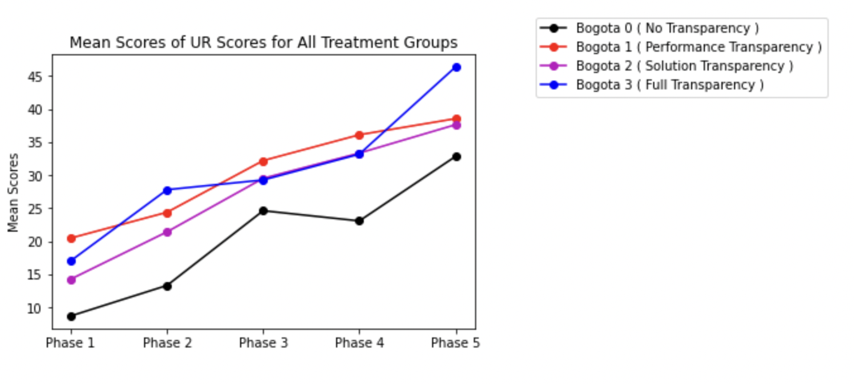
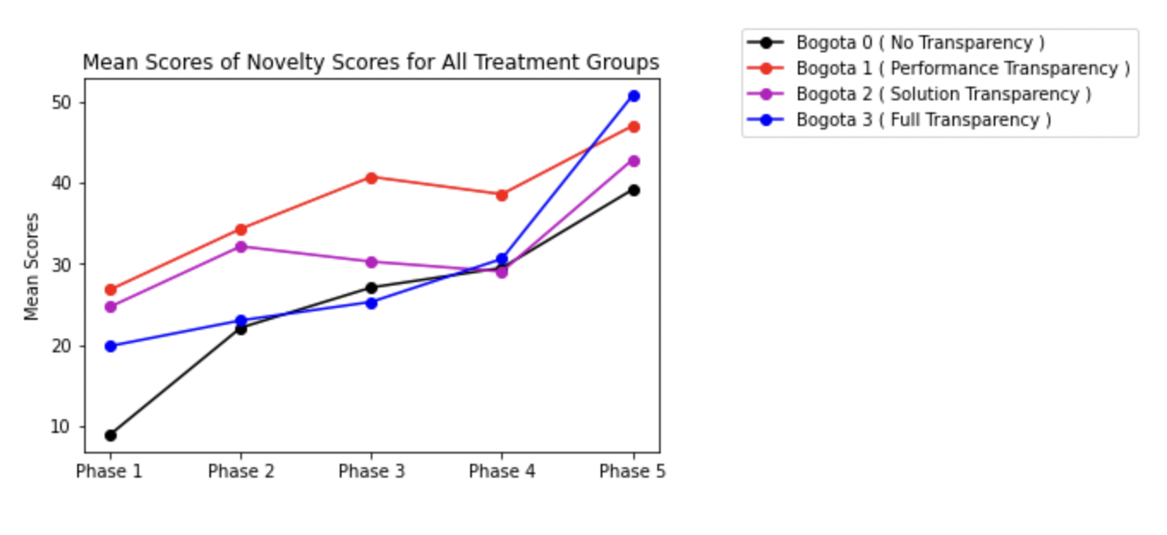
Line Plot of scores in 4 dimensions
Ref Link to Notebook - https://github.com/ironhacks/analysis-2017/blob/main/spring-2017/script/analysis/BoxPlots-LineCharts-BarCharts(Scores%2CLOC%2CD3%2CSurvey).ipynb

Slide 5
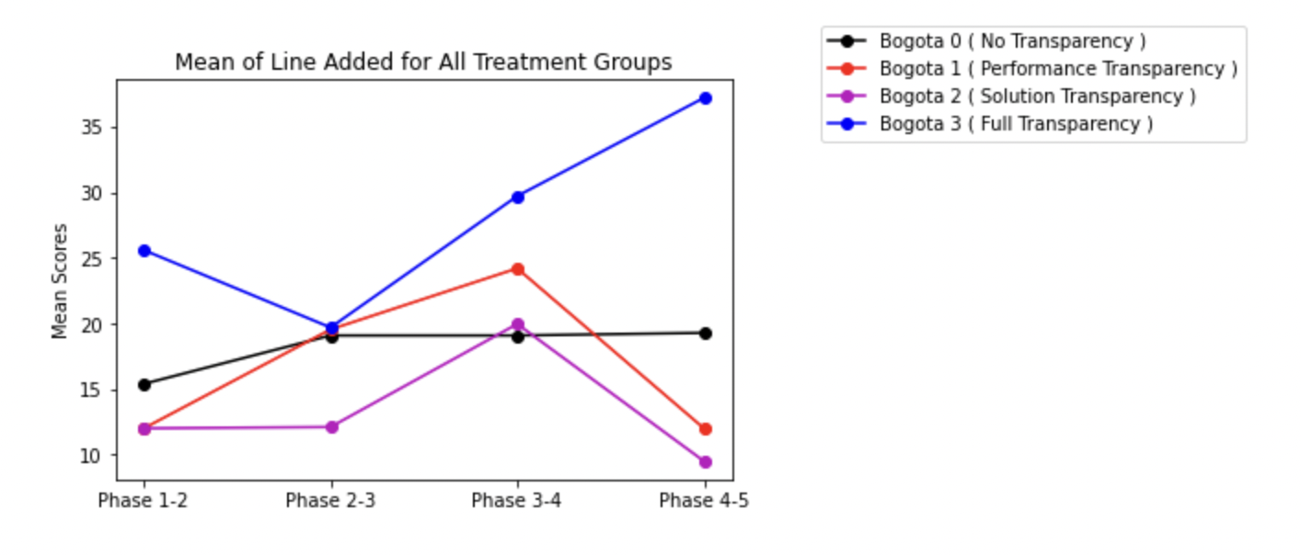
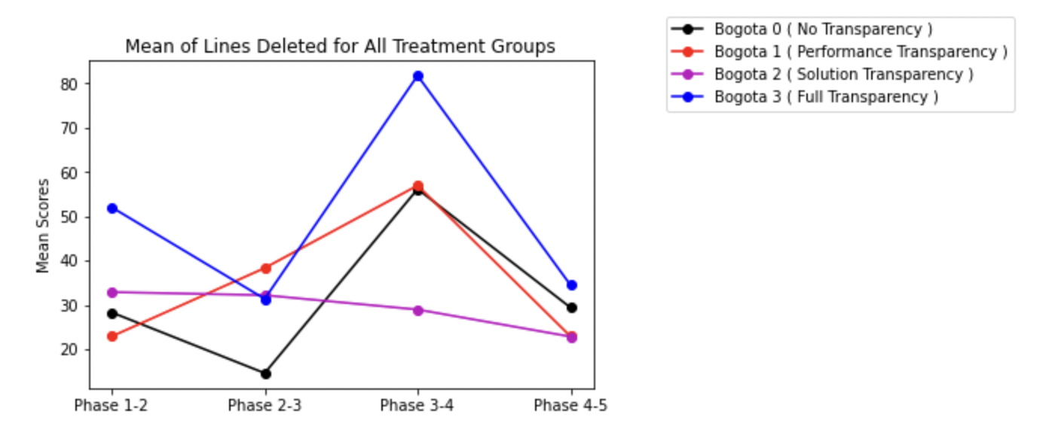
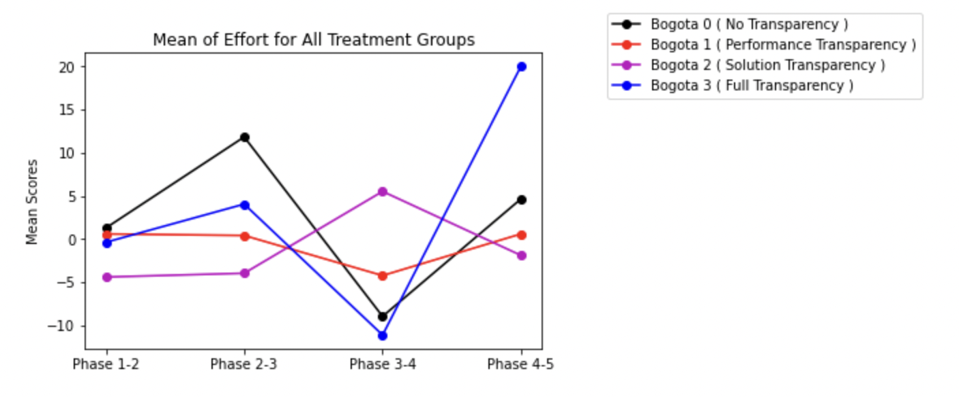
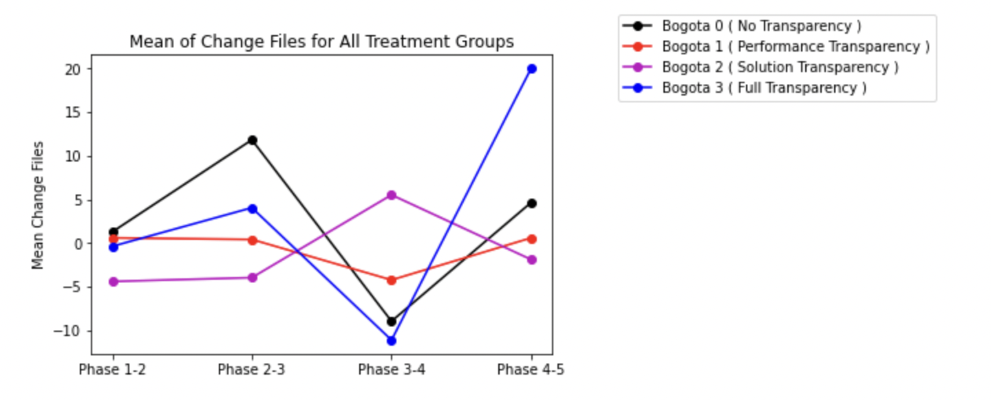
Lines added/deleted/effort/files change
Ref Link to Notebook - https://github.com/ironhacks/analysis-2017/blob/main/spring-2017/script/analysis/BoxPlots-LineCharts-BarCharts(Scores%2CLOC%2CD3%2CSurvey).ipynb

Slide 6
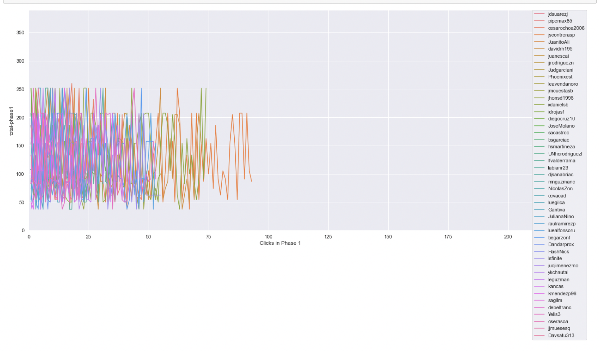
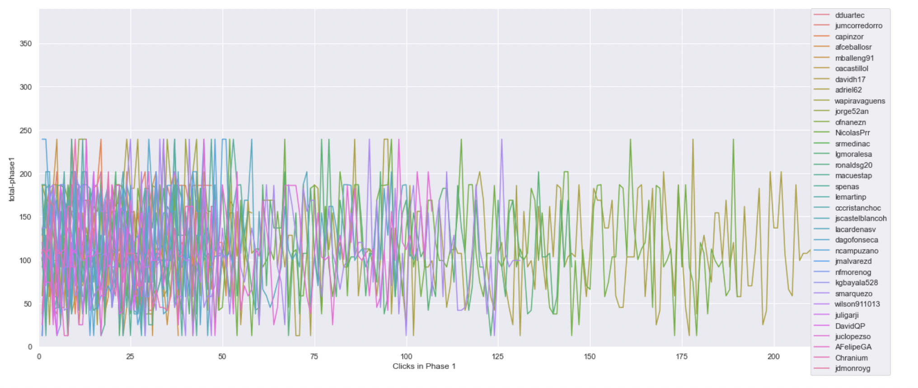
Timeline plot of scores of projects clicked on in phase 1 ( same scale )
Ref Link - https://github.com/ironhacks/analysis-2017/blob/main/spring-2017/script/analysis/Clicks-Analysis(Graphs%2CDescriptive-Analysis).ipynb
Bogota 2 ( Solution Transparency Only ) | Bogota 3 ( Full Transparency )

Slide 7
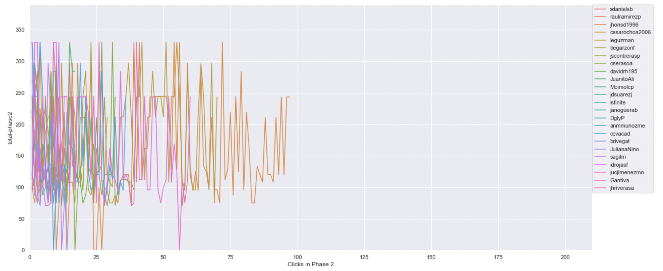
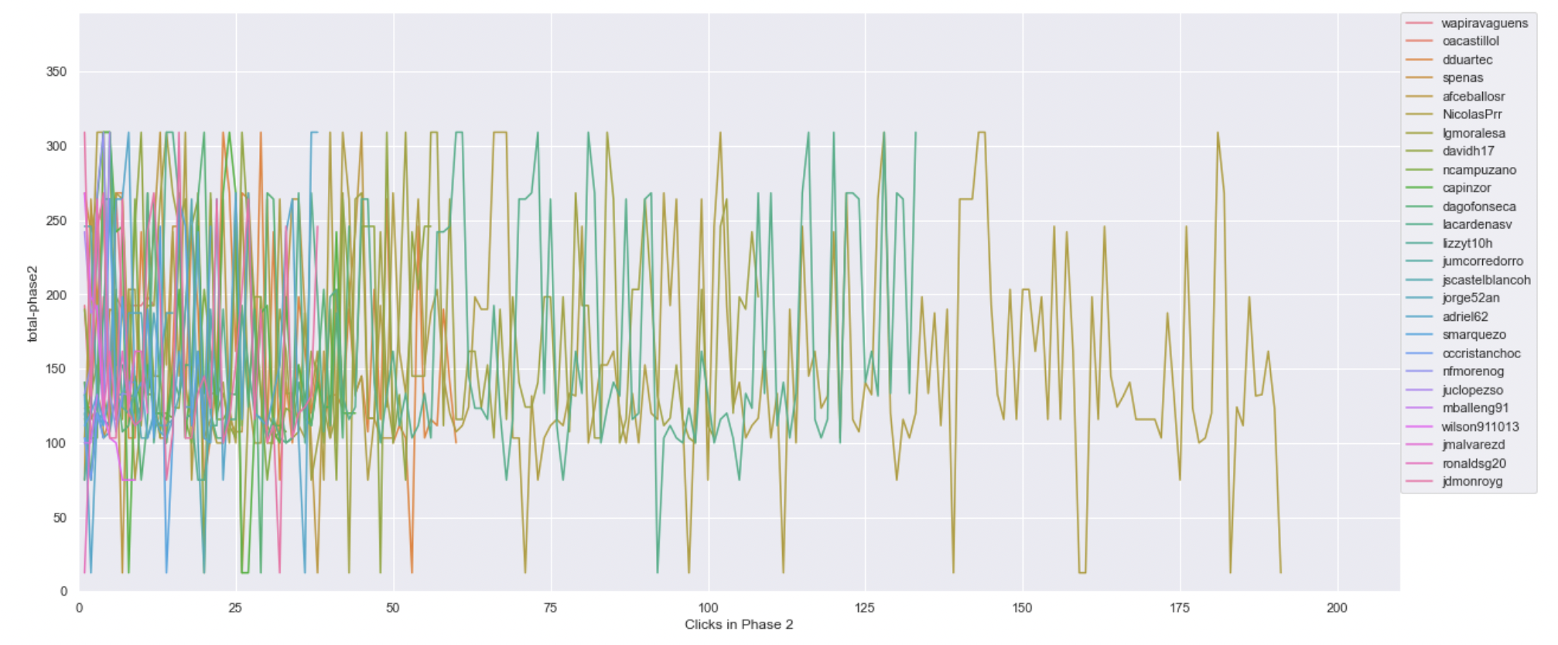
Timeline plot of scores of projects clicked on in phase 2 ( same scale )
Ref Link - https://github.com/ironhacks/analysis-2017/blob/main/spring-2017/script/analysis/Clicks-Analysis(Graphs%2CDescriptive-Analysis).ipynb
Bogota 2 ( Solution Transparency Only ) | Bogota 3 ( Full Transparency )

Slide 8
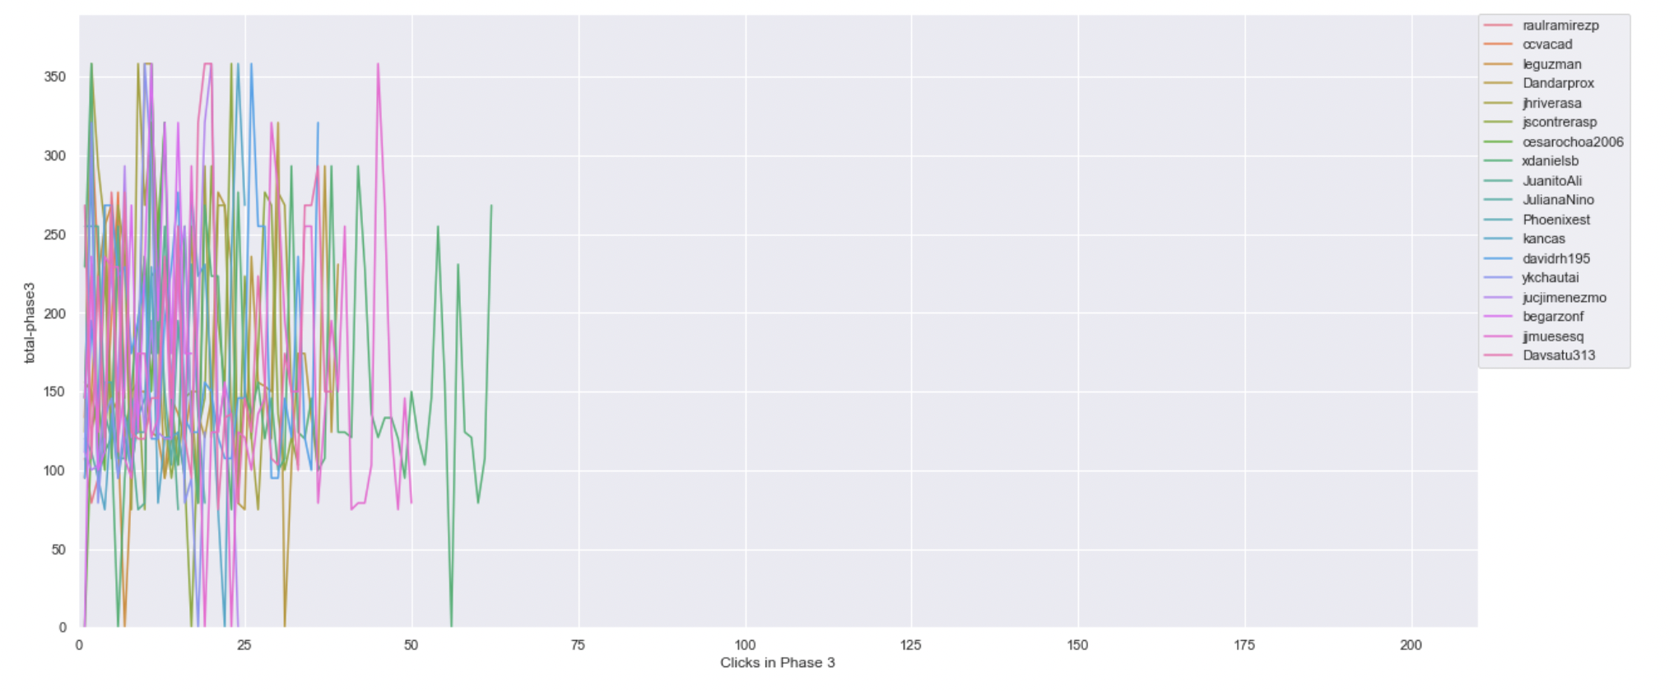
Timeline plot of scores of projects clicked on in phase 3 ( same scale )
Ref Link - https://github.com/ironhacks/analysis-2017/blob/main/spring-2017/script/analysis/Clicks-Analysis(Graphs%2CDescriptive-Analysis).ipynb
Bogota 2 ( Solution Transparency Only ) | Bogota 3 ( Full Transparency )

Slide 9
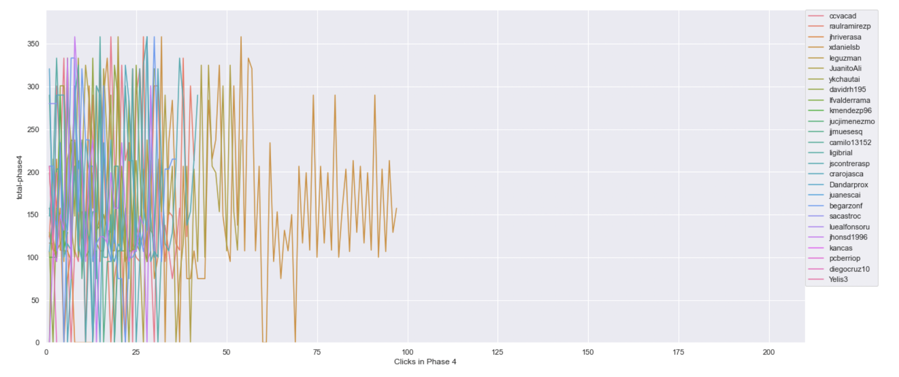
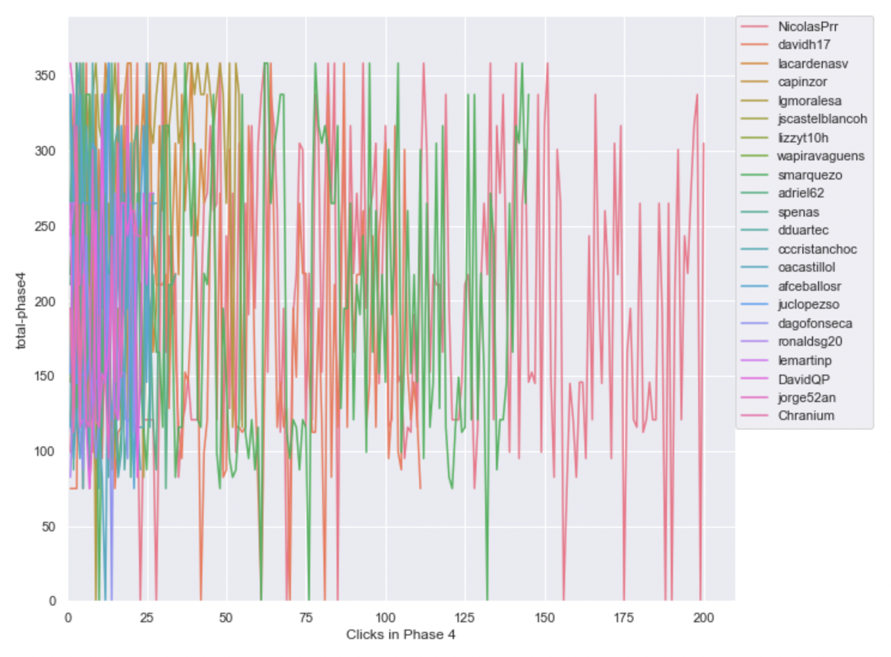
Timeline plot of scores of projects clicked on in phase 4 ( same scale )
Ref Link - https://github.com/ironhacks/analysis-2017/blob/main/spring-2017/script/analysis/Clicks-Analysis(Graphs%2CDescriptive-Analysis).ipynb
Bogota 2 ( Solution Transparency Only ) | Bogota 3 ( Full Transparency )

Slide 10
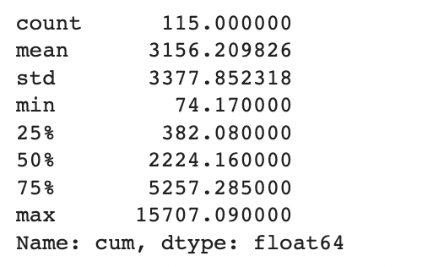
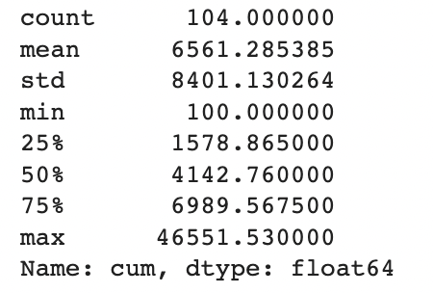
Total Score of the Apps Being Clicked Across All Phases ( Descriptive Analysis )
Ref Link - https://github.com/ironhacks/analysis-2017/blob/main/spring-2017/script/analysis/Clicks-Analysis(Graphs%2CDescriptive-Analysis).ipynb
Bogota 2 ( Solution Transparency ) | Bogota 3 ( Full Transparency )

Slide 11
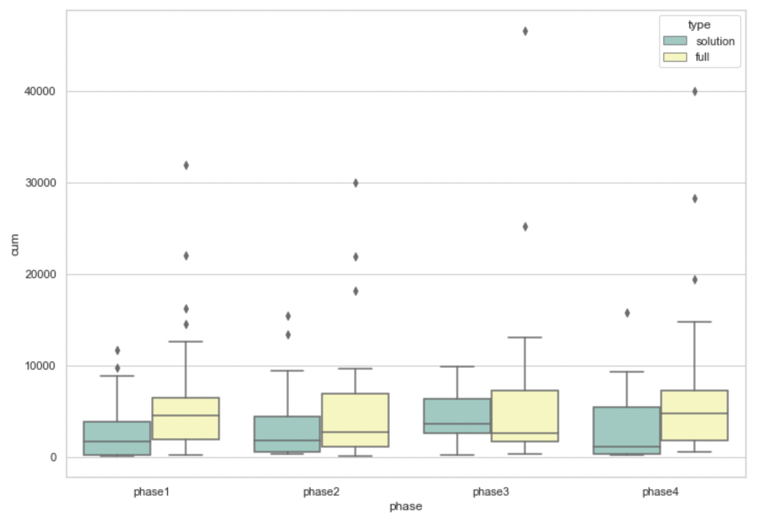
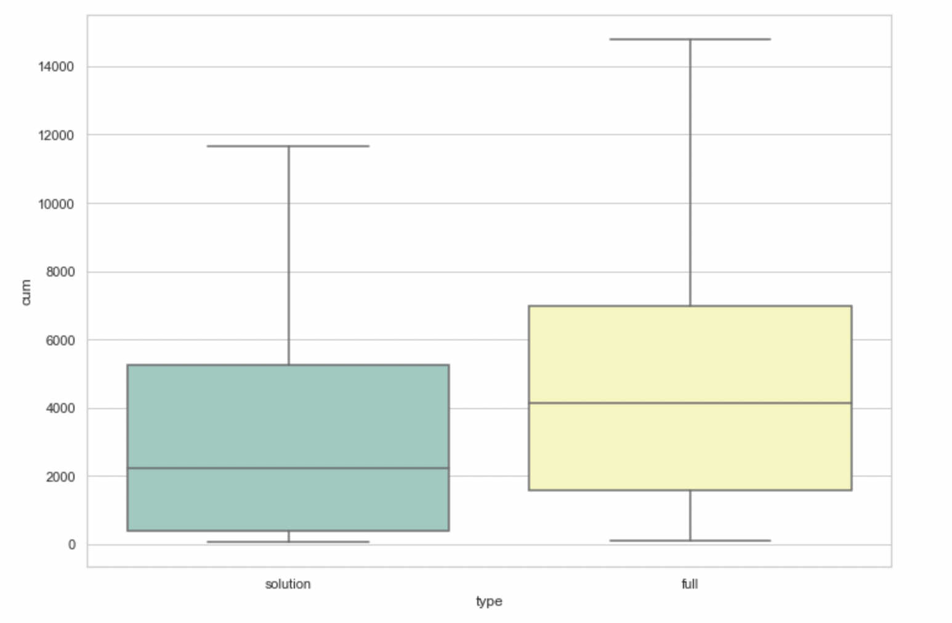
Total Score of the Apps Being Clicked Across All Phases ( box plots )
pvalue=0.00017575311061889564
( Independent T-test )

Slide 12
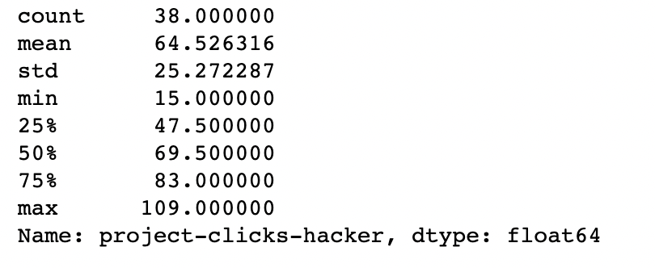
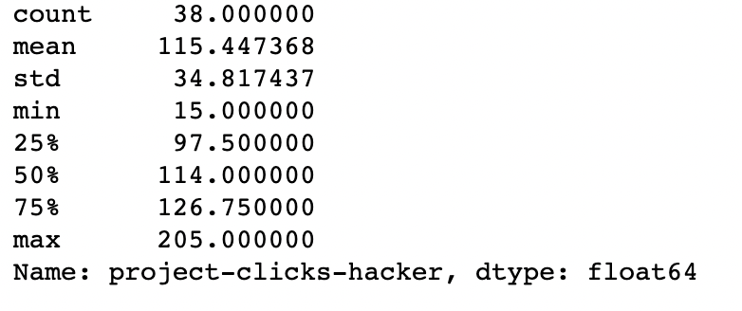
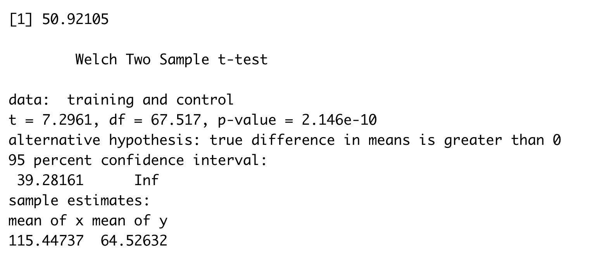
The number of clicks assigned to an app
Bogota 2 ( Solution Transparency ) | Bogota 3 ( Full Transparency )

Slide 13
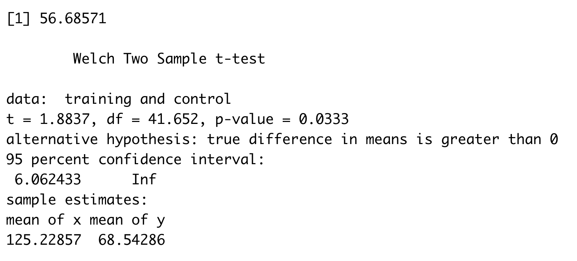
The number of clicks done by a person
Bogota 2 ( Solution Transparency ) | Bogota 3 ( Full Transparency )
Stats for Solution Transparency Min. : 1.00 1st Qu.: 32.00 Median : 55.00 Mean : 68.54 3rd Qu.: 88.00 Max. :250.00 NA's :7 | Stats for Full Transparency Min. : 1.0 1st Qu.: 43.0 Median : 60.0 Mean :125.2 3rd Qu.:128.5 Max. :821.0 NA's :6

Slide 14
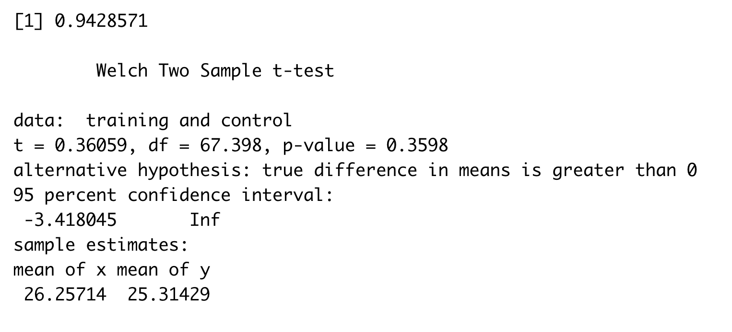
The number of unique apps explored
Bogota 2 ( Solution Transparency ) | Bogota 3 ( Full Transparency )
Stats for Solution Transparency count 35.000000 mean 25.314286 std 10.408626 min 1.000000 25% 20.500000 50% 27.000000 75% 34.500000 max 37.000000 | Stats for Full Transparency count 35.000000 mean 26.257143 std 11.443834 min 1.000000 25% 21.500000 50% 29.000000 75% 36.500000 max 38.000000

Slide 15
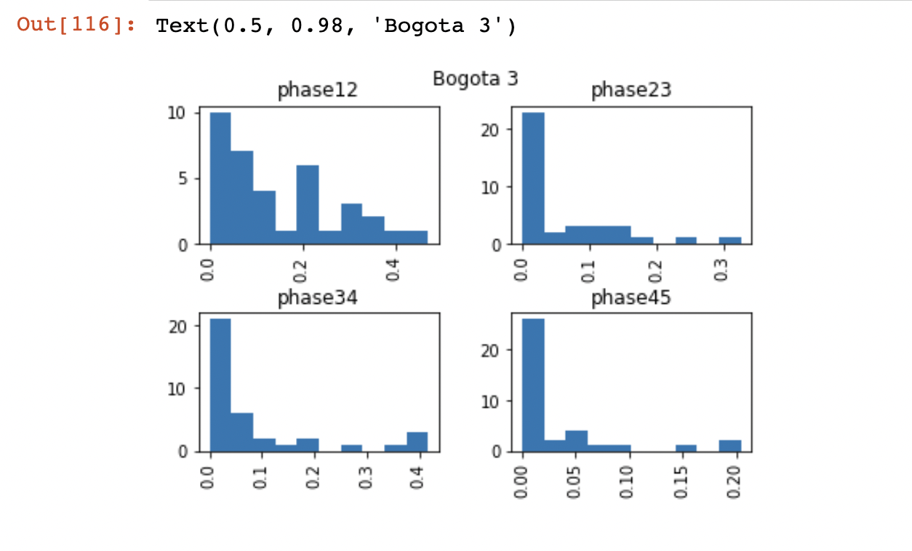
Distribution Plot for Exploration Metric [ Full Transparency ]

Slide 16
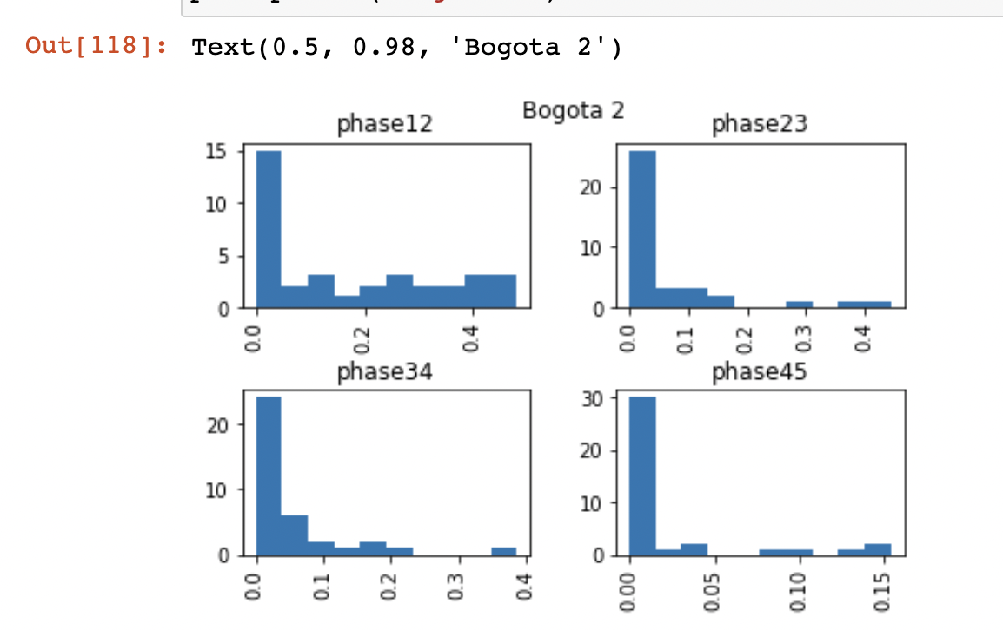
Distribution Plot for Exploration Metric [ Solution Transparency ]

Slide 17
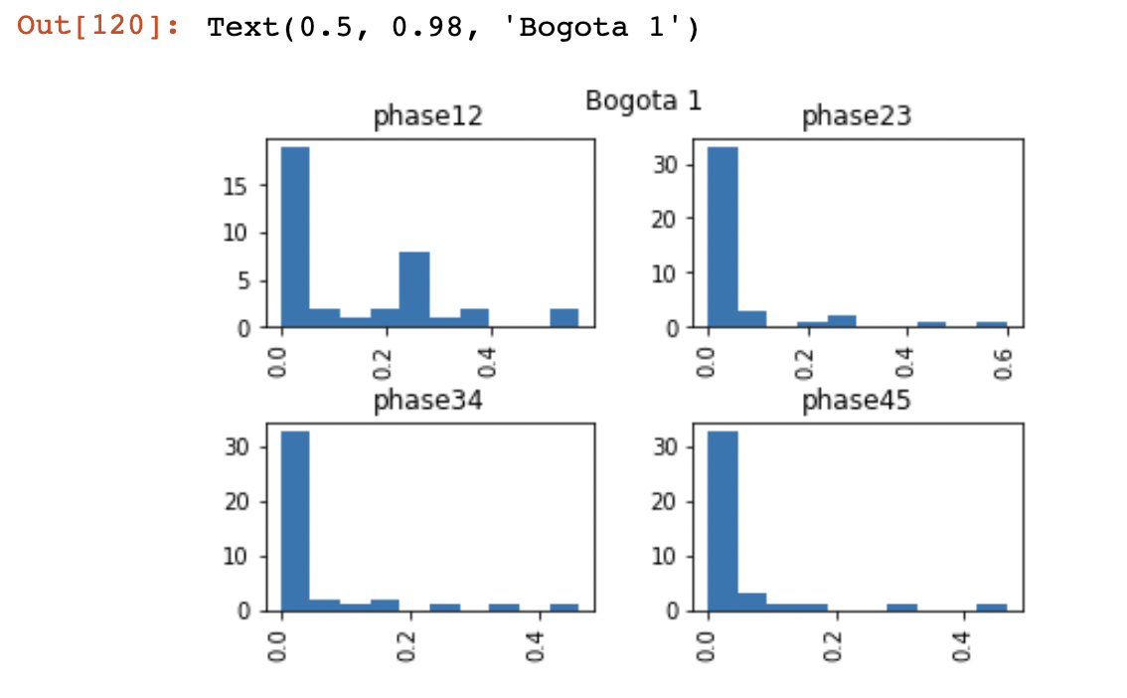
Distribution Plot for Exploration Metric [ Performance Transparency ]

Slide 18
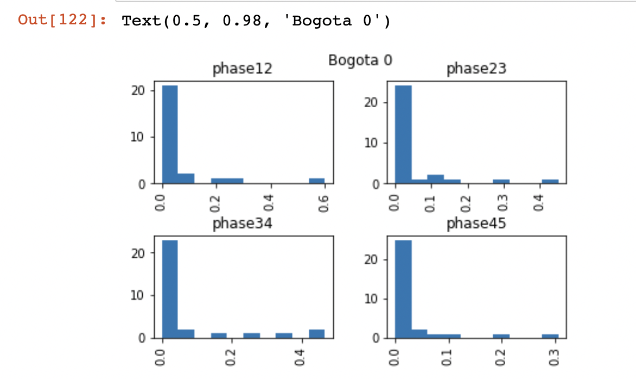
Distribution Plot for Exploration Metric [ No Transparency ]

